Slide 1

Sparse Matrix Multiplication Acceleration Unit
A Custom-instruction
Praneeth Kodavati
CS24BTECH11034

Slide 2

Abstract of Acceleration Unit
This project adds a new instruction “sparse_mul” to the RISC-V simulator to accelerate sparse–dense matrix multiplication. Most entries in a sparse matrix are zero, so multiplying them traditionally wastes time. The design introduces metadata-based fetching that allows the hardware to skip zeros and process only useful values. A new SM-type instruction format, along with a four-stage pipelined datapath and compatibility checker, enables efficient execution and significantly reduces computation cycles for large sparse matrices.

Slide 3
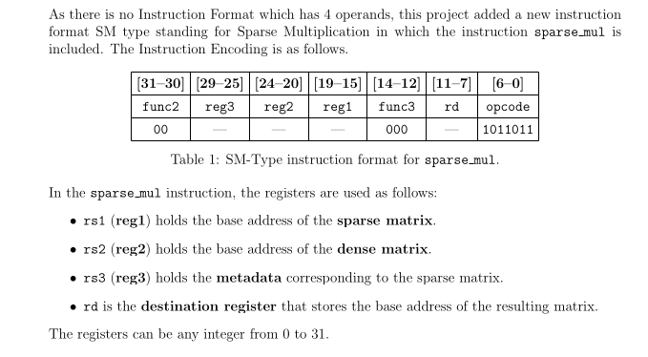
Instruction Encoding

Slide 4
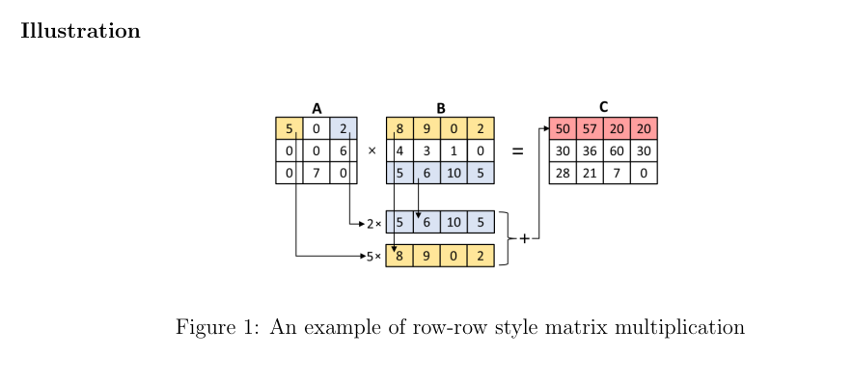
Choosing Optimal Algorithm
There are many ways in which 2 matrices can be multiplied out of which we choose the best algorithm where we can skip fetching zero elements and their computation to calculate efficiently. Hence row-row style is most appropriate.

Slide 5
Meta-Data design of a sparse matrix
Offset based meta-data:
Offset is the distance between 2 consecutive non-zero values in linear representation of a matrix. Each Offset is a 32-bit unsigned integer. If the offset is forcing a row change then msb of the offset is set to 1.
18 | 0 | 0
0 | 12 | 11
0 | 39 | 0
3 MSB | 1 | 1 | 1 MSB | 1 | 2 MSB
Sparse Matrix
Note: First element of a row is always fetched, why ?

Slide 6
Data-Path
The main datapath is for handling non matrix instructions which is a single stage processor.
Main Datapath
IF | ID | EX | MEM | WB
If sparse_mul instruction is decoded.
Matrix Validation Unit
If Valid
4-stage Pipeline
OF | VF | SV | ACC

Slide 7
More about pipeline….
This Pipeline has separate clock as time taken by slowest instruction and time taken by slowest stage aren’t same.
In a pipelined processor, instructions are executed parallely, In sparse_mul pipeline, we define something called work unit which gets executed parallely.

Slide 8
Work Unit
Work Unit :
A work unit is the entire process of fetching a non zero value in sparse-matrix, Let the column index
of this value is ‘i’, Now fetch the row i of dense matrix. Multiply the scalar number with row i of dense matrix. Add this row to an accumulator, if the current element is last non-zero in its row then this accumulator is written to the output buffer. This entire process is denoted by 1 work unit. The 4-stage pipeline executes this parallely.

Slide 9
Some Hardware inside Pipeline
Storage Unit:
It is similar to register file in a regular 5-stage pipelined processor. Here it stores values like Base Addresses, Number of rows and columns, Accumulator

Slide 10
Some Hardware inside Pipeline
Write-Back Buffer:
an accumulated vector is written to memory only during the execution of last work unit of that row. Hence saving time for it in last stage for every work unit is waste of time. So we will write the accumulated vector to Buffer.
We will discuss later about when the buffer is emptied.
3 Pipelined Registers to avoid data hazards
Note: The buffer size never crosses 2 at any point.

Slide 11
Stages inside Pipelining
Stage-1 OF : It fetches offset from meta-data matrix
Stage-2 VF: It fetches dense matrix row and simultaneously empties buffer (both have same size and have different ports). It also fetches non zero scalar from sparse matrix
Stage-3 SVMUL : It multiplies scalar fetched and dense row fetched and pass it to next stage. (Basically performs scalar multiplication).
Stage-4 ACC : It accumulates all these vectors from 3rd stage until last work unit of a row is found. If found it write it to buffer and sets accumulator to zero.

Slide 12
Problems in stage-2
In Pipelining all stages should take similar amount of time for efficiency. In second stage we are fetching entire row of dense matrix which can be as large as 2^31 -1. Hence this stage will become so slow and hence pipeline does more bad than good.
To combat this, multiplication is done lane wise i.e we only fetch 8 columns at a time. The dense matrix is divided into several matrices whose number of columns are 8.

Slide 13
Clock Period of this pipeline
From this pipeline its evident that second stage is the slowest one, it fetched 8 elements i.e 8 * 64 bytes from data memory.
By using interleaved memory layout for fetching we can say that Clock period 2 is 1.5x times of clock period-1. But they should have integral relationship hence clock period-2 is set twice of clock period-1. To simply express if it takes x cycles in sparse pipeline to execute an instruction, the main datapath is stalled for 2x main cycles.

Slide 14
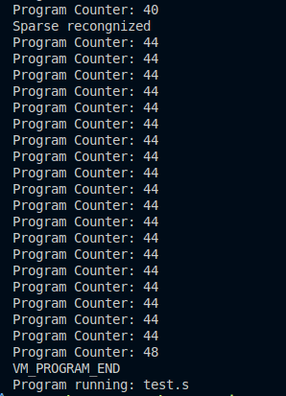
Program counter
Counter got stuck for several cycles because the main datapath is stalled until sparse_mul is executed

Slide 15
Performance Analysis
Let’s assume there are 2 matrices of dimensions (a x b) , (b x c) . ‘s’ denotes the sparsity of the matrix-1 in fraction,
A matrix multiplication program on RISC-V runs for approximately 8(abc) cycles.. source
In the accelerator , number of work units are approximately ab(1-s) * c/8. So number of main clock cycles is twice of this = abc(1-s)/4.

Slide 16
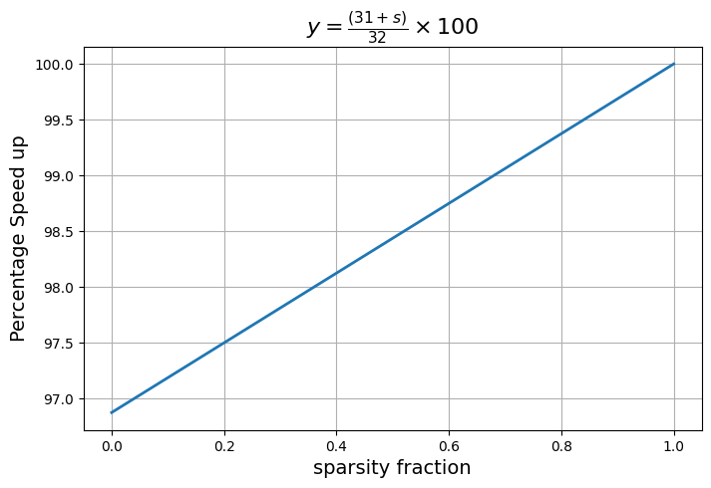
Performance Analysis

Slide 17
The Meta-Data Matrix
Writing meta-data for sparse matrix every time is not so feasible as matrices can be very large. Considering this an instruction of R-type mutli-cycle instruction ‘meta’ has been added to the simulator which doesn’t focus much on throughput because once meta-data for a matrix is created you could use it infinite times.

Slide 18
Instruction Encoding for meta instruction
R - format
OP code - 011011
Func7 - 1000000
Func3 - 100
Instruction use : meta rd, rs1, x0.

Slide 19
Testing
Checking matrix multiplication is never easy due to the scale of the operation, hence manual checking offers very little use.
Hence a tester.cpp is created which will generate random matrices and checks whether output and expected output is same.

Slide 20
Testing
The program has 2 modes of execution:
Performance mode : normal mode in which we runs.
Testing mode : we run in this mode to check correctness.
The modes can be toggled by the command
mconfig Execution run_mode testing_mode/performance_mode

Slide 21
Testing
tester.cpp randomly generates matrix dimensions and sparsity levels within a specified computational budget (∑ a·b·c ≤ MAX_OPS), constructs sparse matrix A and dense matrix B, and performs software-based multiplication to produce a standard output. The matrices are then flattened and checked with output from simulator in testing mode RISC-V virtual machine.

Slide 22
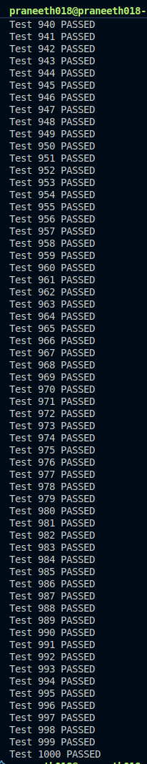
Few snapshots from randomly run cases.
The tester takes ‘t’ the number of test cases and sum of product of abc over all test cases.

Slide 23

THANK YOU

